Slide 1
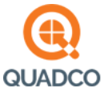
Tim Horyna
Intermountain Region Sales Representative
January 2025

Slide 2
About Us
Founded in 1867
Harrington Hoists is a leading supplier/manufacturer of hoists, overhead traveling bridge cranes, jib/gantry cranes, end trucks, below the hook lifting devices, and accessories.
1990
Harrington Hoists became a wholly owned subsidiary of KITO Corporation, the largest global producer of chain hoists (founded 1932).
January 2023
The Crosby Group, a leading provider of lifting and rigging solutions, and KITO Corporation announced the completion of their business combination under the name Kito Crosby.
Harrington Facility Locations
Manheim, PA (HQ)
Elizabethtown, PA
Corona, CA
South Holland, IL

Slide 3
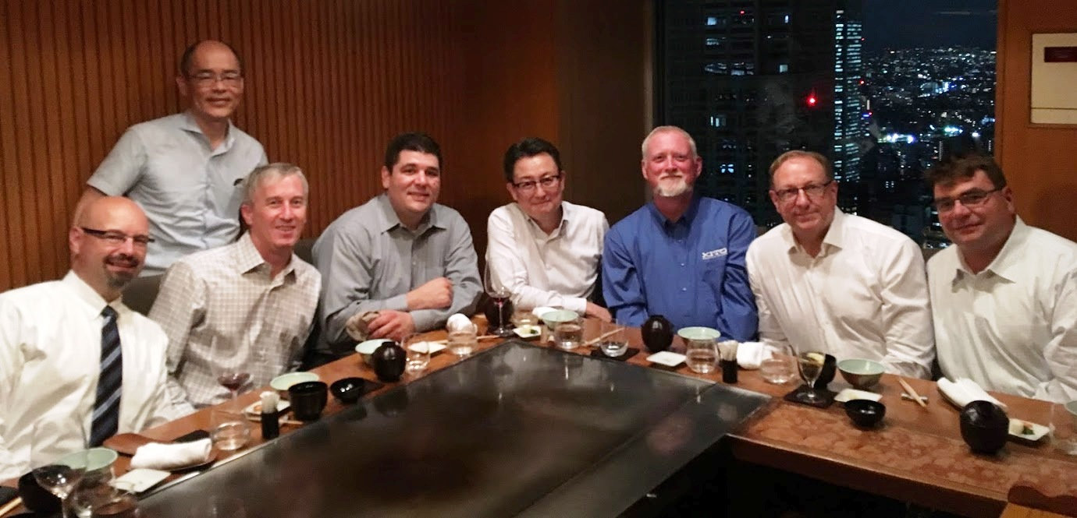
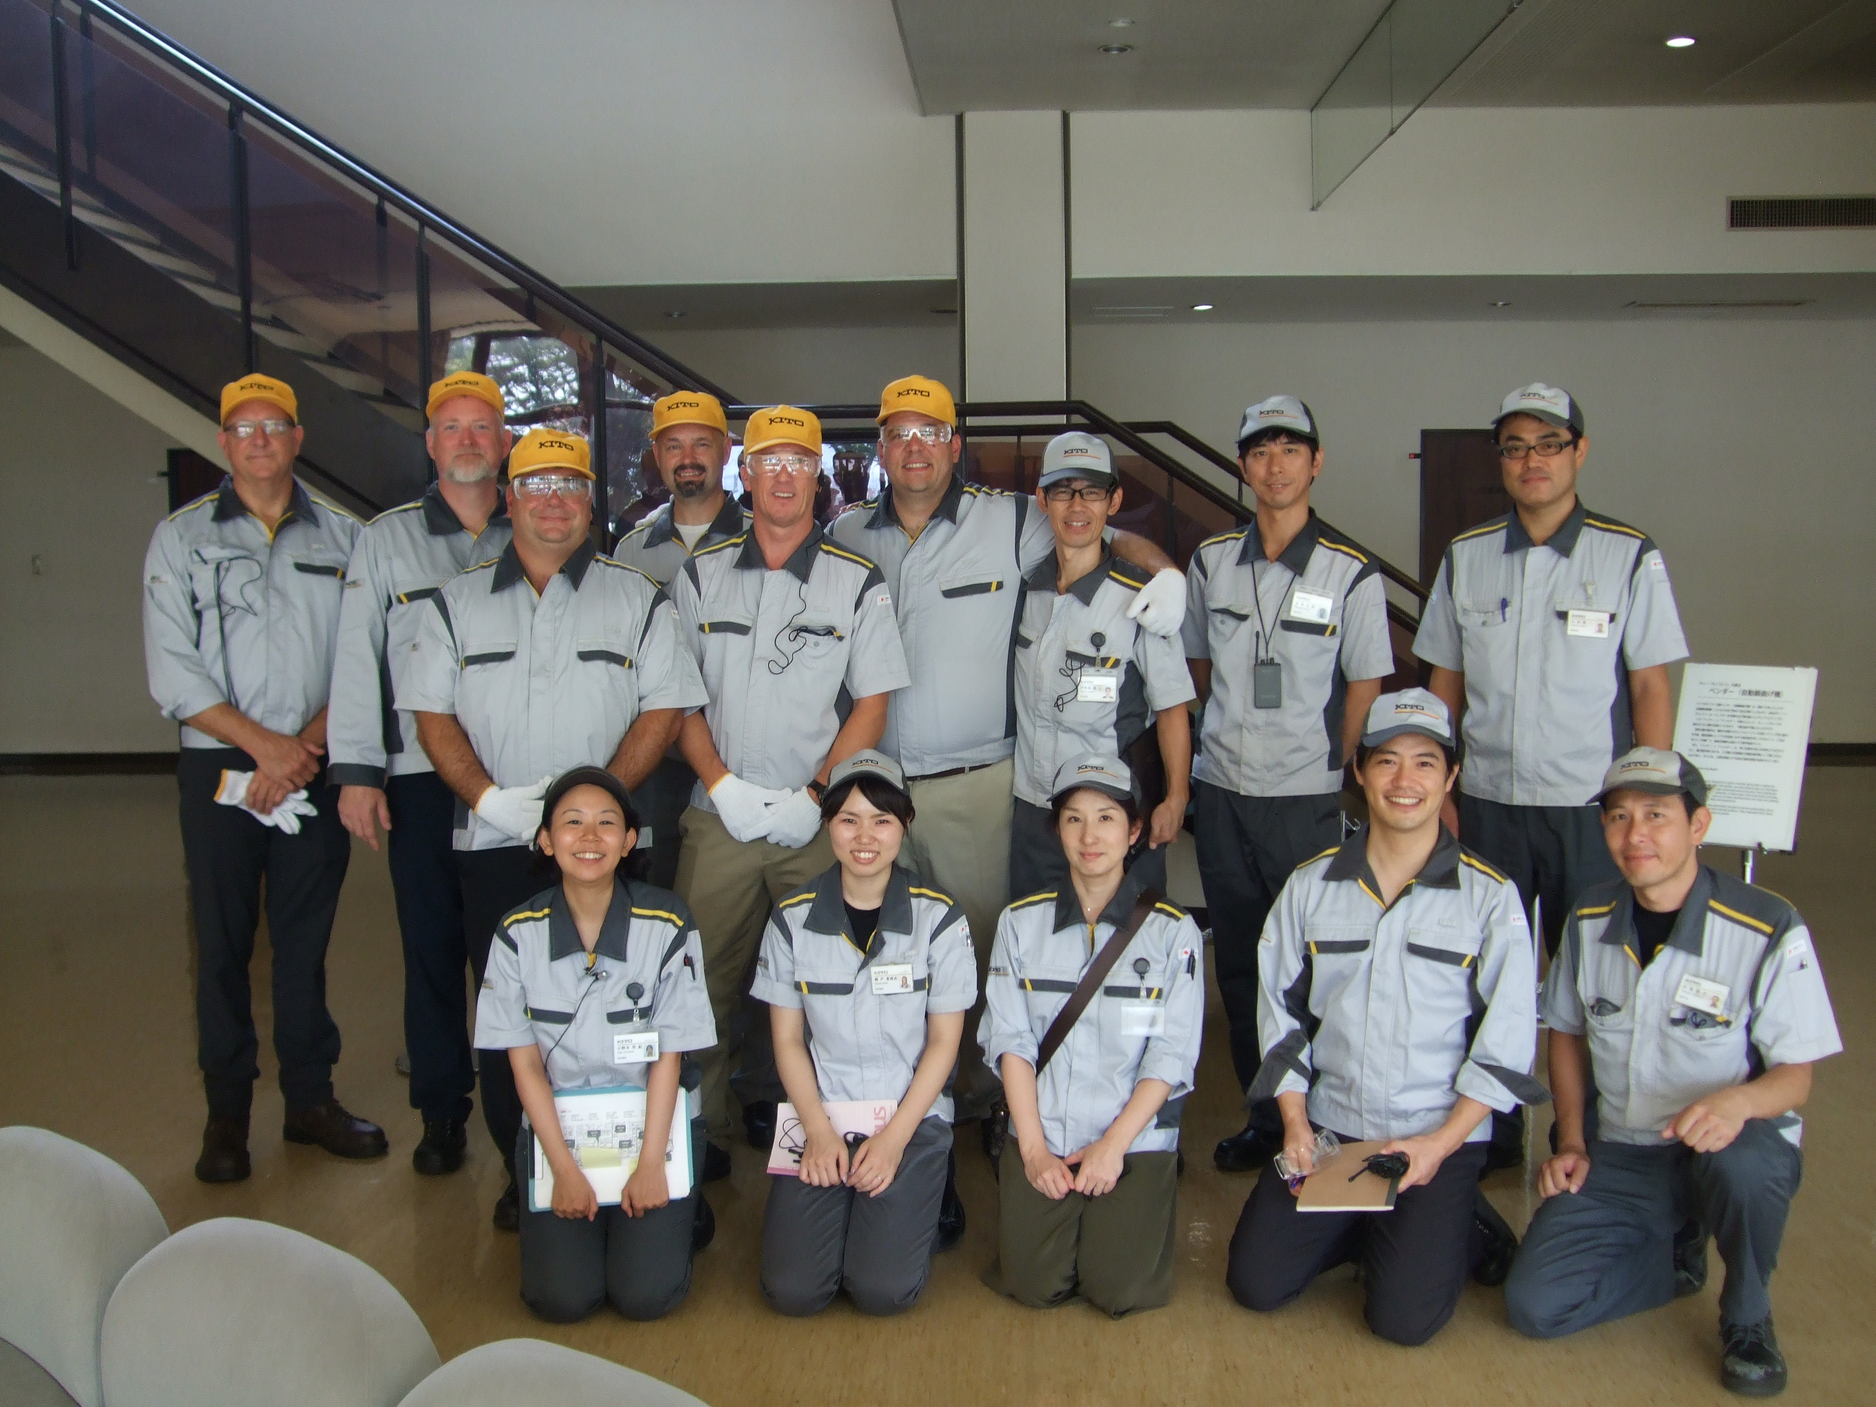
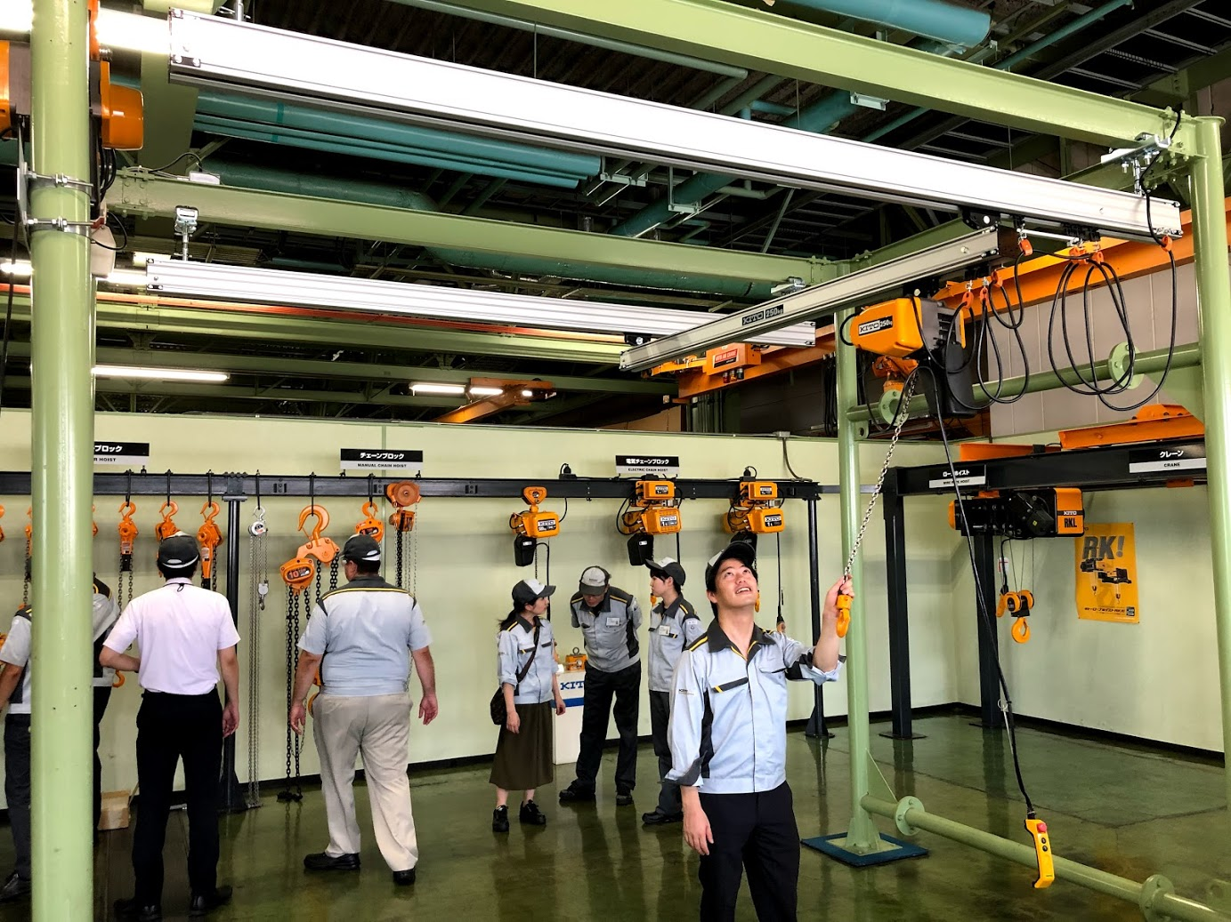

Slide 4
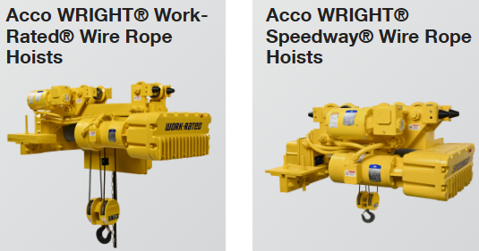
What’s new?

Slide 5
Hoist Terms
Capacity
Maximum weight load a hoist is designed to lift or pull
Headroom
Distance between the top hook (or bottom of beam if paired with trolley) and the bottom hook (in its uppermost position)
How much space the trolley/hoist takes up in the application
Lift
Maximum distance the bottom hook can travel
Flange Width
Measurement of the bottom flange of a beam that a trolley will traverse on

Slide 6
Questions To ASK
What are you lifting? / What is the application?
What weight capacity?
What type of hoist do you need?
Manual, Electric, Air
Chain or Wire Rope
Single or 3-Phase Power
Top hook mount or trolley?
Push, Geared, Motorized
How much LIFT do you need?
What type of environment is this going to be exposed to?
Outdoor? Wet? Corrosive?

Slide 7
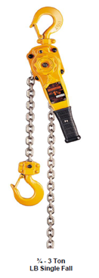
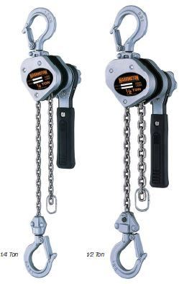
Manual Chain Hoists
Lever Hoists: “Come-a-longs” / “lever pullers”
LX Mini
LB
Rated #1 selling lever hoist in USA
¾ - 9 ton capacities
Compact, lightweight design
Corrosion-resistant grade 100 nickel-plated chain Patented free-wheel safety mechanism
¼ & ½ Ton Capacities
Super-compact, high-seller

Slide 8
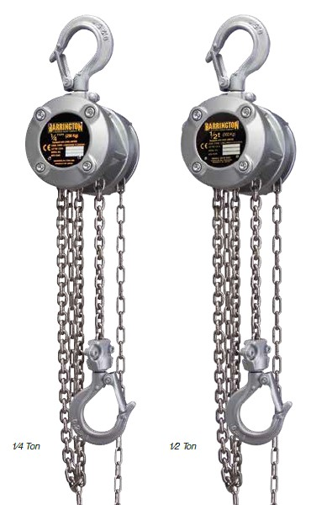
Manual Chain Hoists
Hand Chain Hoists: “Chain Falls”
CF
½ - 5 ton
Economical design Aluminum body Product of the USA
CB
½ - 100 ton
Premium offering
Steel body
Slip clutch standard
CX Mini
¼ and ½ ton
Lightweight
Compact

Slide 9
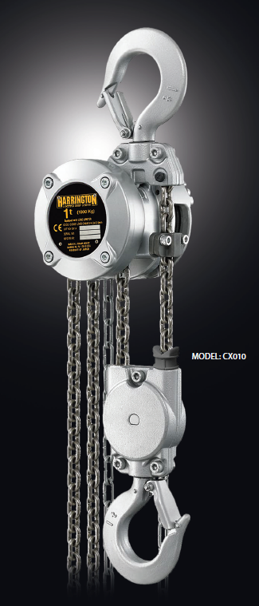
NEW product CX010 Mini
Compact, Lightweight
CX010-10’ = 17 lbs.
CF010-10’ = 29 lbs.
CB010-8’ = 25 lbs.

Slide 10
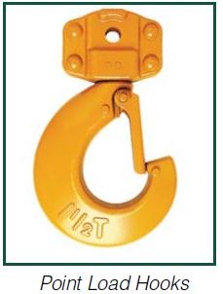
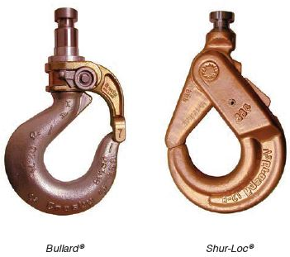
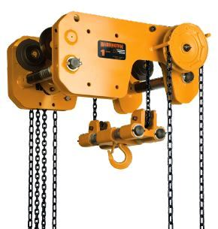
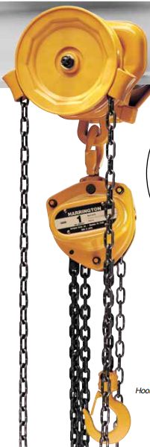
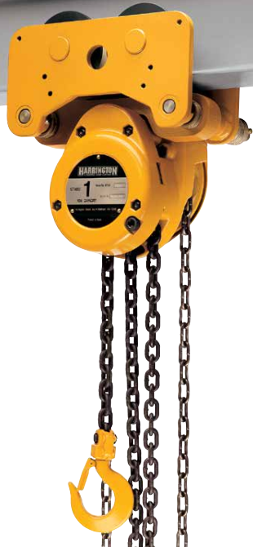
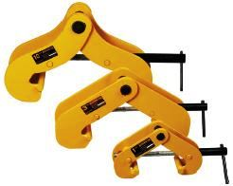
Special Applications
Upgraded Hooks
Low Headroom
Hand Chain Hoists
Hoist & Trolley Combo
Universal Beam Clamps (UBC)

Slide 11
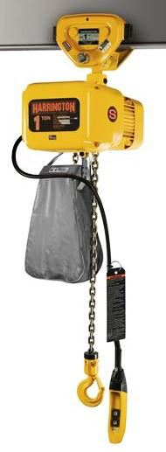
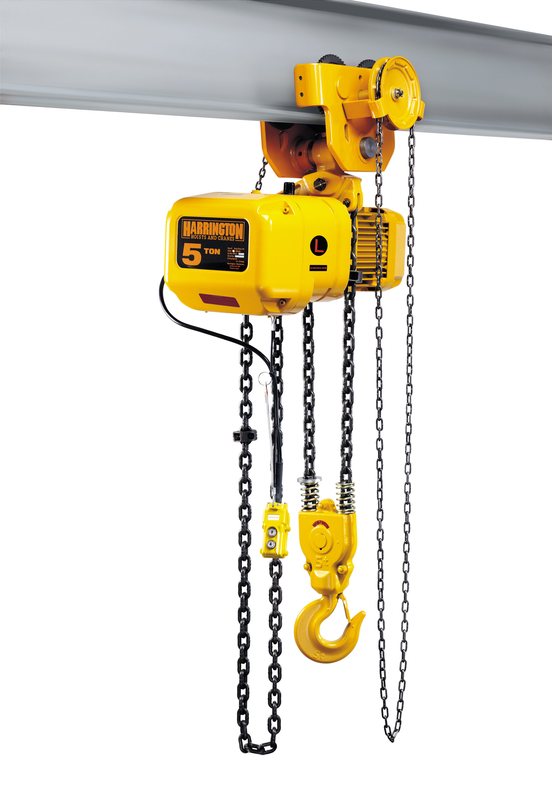
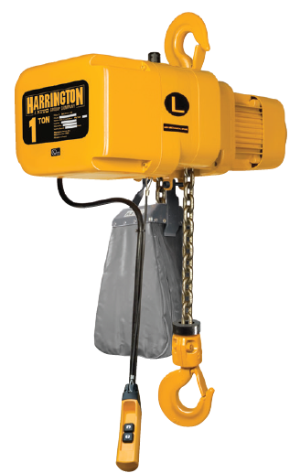
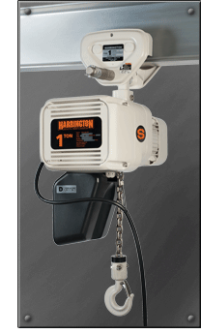
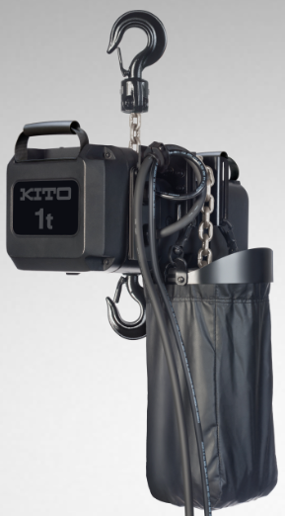
Electric Chain Hoists
Most industrial grade electric chain hoists on the market!
Single phase or 3-phase voltages
Capacities ranging from 250 lbs – 20 tons
Multiple lift speed options (VFD)
Food Grade (FG)
Hazardous Locations (HAZLOC)
Entertainment Motors (KEG)

Slide 12
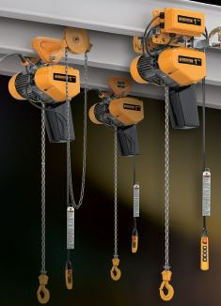
EQ / SEQ Electric Chain Hoists
EQ = 3-phase voltage
SEQ = Single phase voltage
1/8 - 1 ton capacity
Variable Frequency Drive (VFD)
What’s the big deal?
Pair with workstation jib cranes

Slide 13
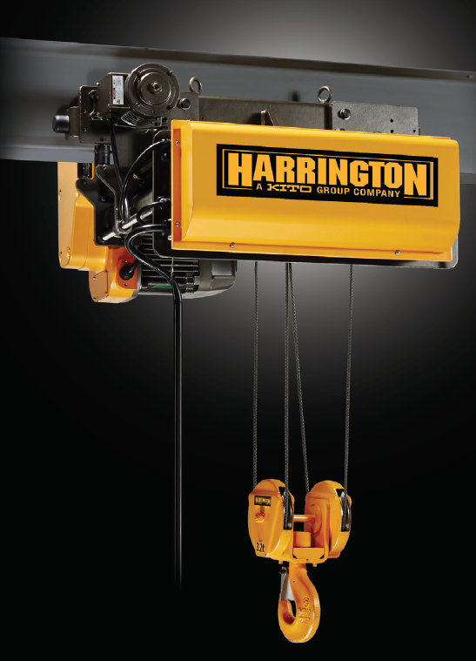
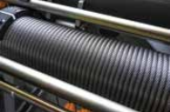
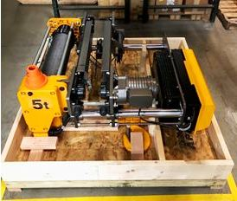
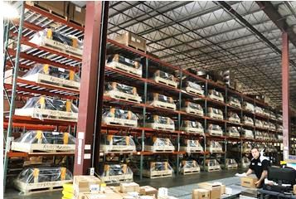
Electric Wire Rope Hoists
RY Model
3, 5, 7.5, 10 ton
VFD Hoist / Trolley
Low-headroom
IN STOCK (PA)
Why Wire Rope??

Slide 14
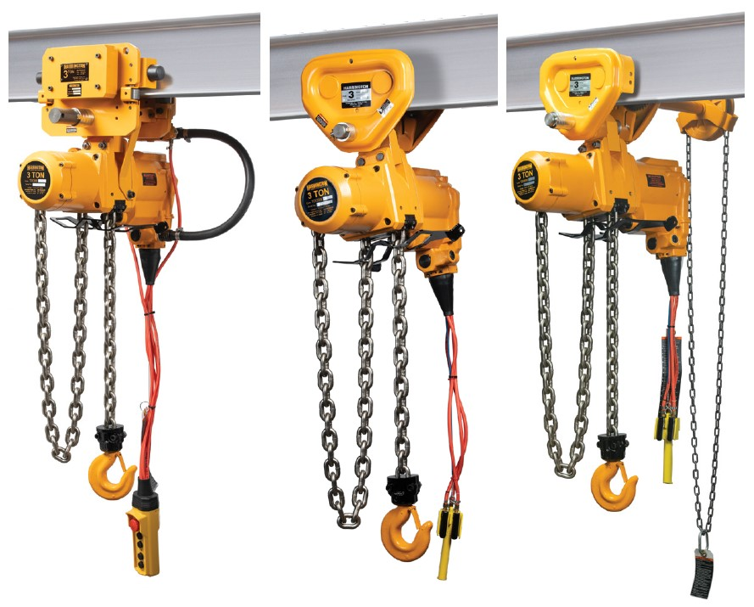
Air/Pneumatic Chain Hoists
250 lbs. – 6 Ton Capacity
Multiple Configurations
Feathering Speed Control
WHY NEED AIR HOIST??

Slide 15
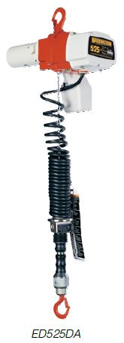
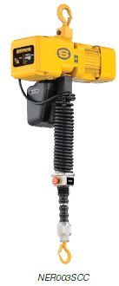
Ergonomic Solutions
Cylinder & manipulator control
One-handed operation
Speed control & precise load placement
Models
Single phase: ED-DA
3-phase: NERCC
Pneumatic/Air: AHM
Great for assembly line & workstation applications!

Slide 16
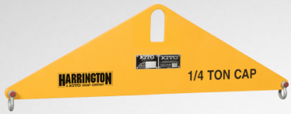
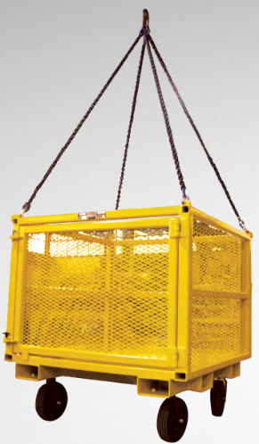
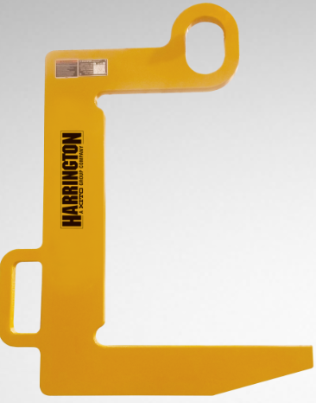
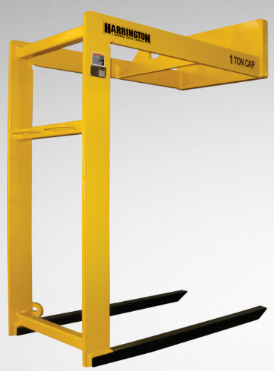
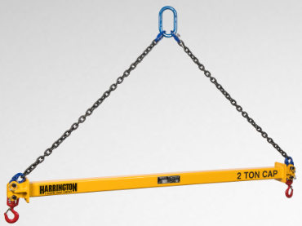
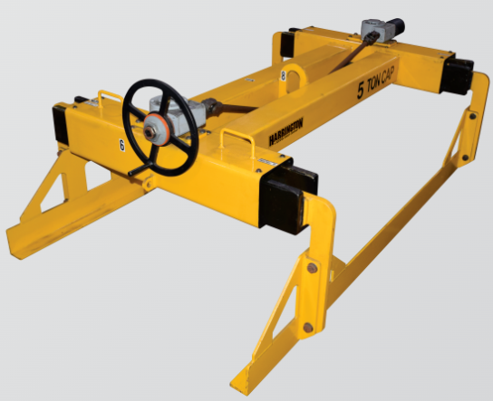
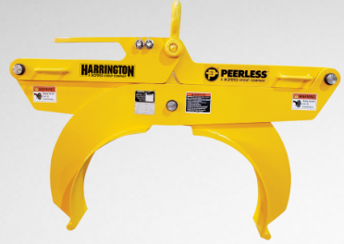
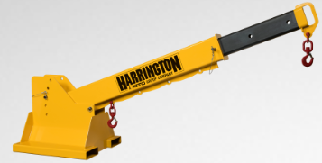
Below The Hook/Material Handling
Proof Tested to 125% of capacity
Certified to OSHA & ASME standards
Made in USA

Slide 17
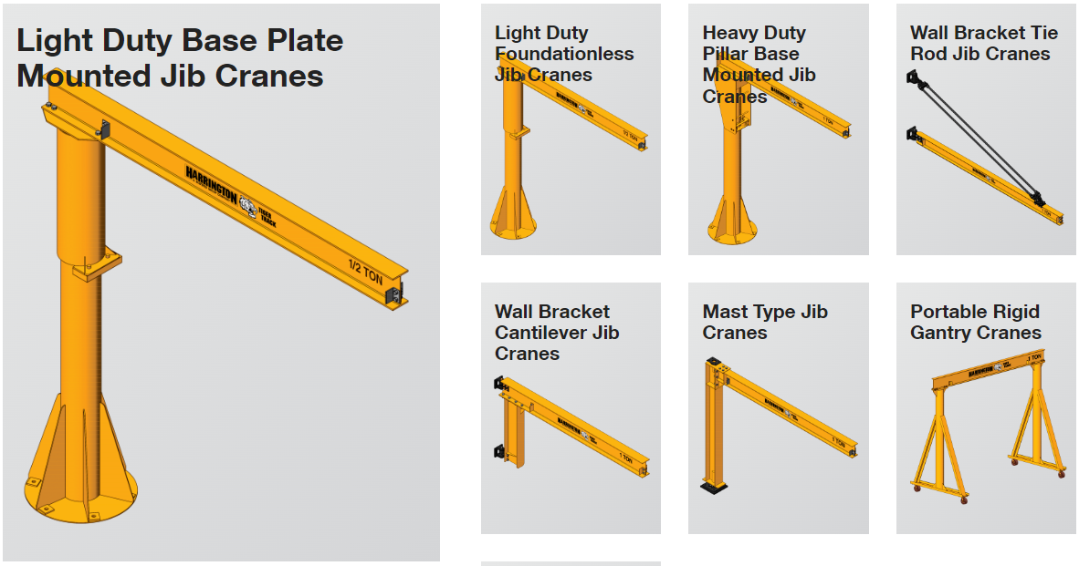
Cranes

Slide 18
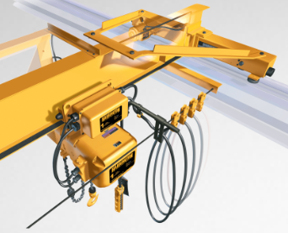
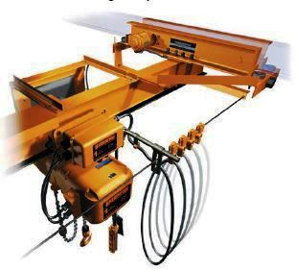
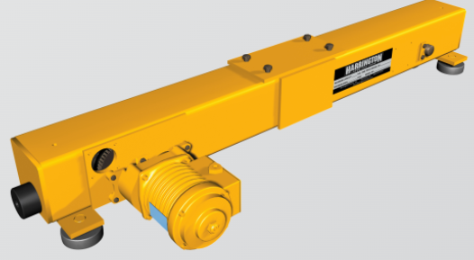
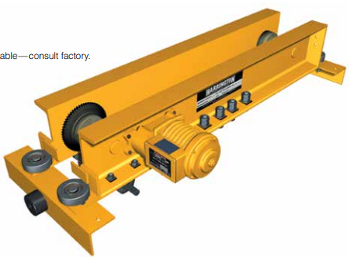
Complete Cranes & Components
Top Running and Underhung
Single Girder
Up to 10 Ton
60’ Span
Push & Geared Options
Up to 5 Ton
45’ Span
End Trucks
Top Running and Underhung
Motorized, Push, Geared

Slide 19
Resources
Sales Representative: Tim Horyna
801-599-9421
Tim.Horyna@kitocrosby.com
Customer Service: 800-233-3010
CustomerService.HHI@kitocrosby.com
Parts: Parts.HHI@kitocrosby.com
Product Support: TechSupport.HHI@kitocrosby.com
Website: www.harringtonhoists.com
Trainings: Sales Academy, Repair Schools
www.harringtonhoists.com/training
Online Customer Portal:

